Slide 1
Video Game Sales data analysis
Using MySql and power bi
Made by : MD Sikander
BCA 5TH Semester , Jamia Hamdard University

Slide 2
Overview of this project
The video game industry is the industry involved in the development, marketing, and monetization of video games. It encompasses dozens of job disciplines and its component parts employ thousands of people worldwide.
Every year it feels like the gaming industry sees the same stories—record sales, unfathomable market reach, and questions of how much higher the market can go.
Problem Statement
From the point of view of an investor or gaming company we want to know the popular genres and platforms which have more sales over the year so that we can invest or publish more games on those genre and platform.

Slide 3
About Dataset
Here I used a dataset having sales records of North america , europe , japan and other region as well as other global sales of games on different platform published by different gaming company.
I picked this dataset from kaggle and this Dataset Fields includes:-
Rank - Ranking of overall sales
Name - The games name
Platform - Platform of the games release (i.e. PC,PS4, etc.)
Year - Year of the game's release
Genre - Genre of the game
Publisher - Publisher of the game
NA _ Sales - Sales in North America (in millions)
EU _ Sales - Sales in Europe (in millions)
JP _ Sales - Sales in Japan (in millions)
Other _ Sales - Sales in the rest of the world (in millions)
Global _ Sales - Total worldwide sales.
This dataset contains 10 columns and 15336 rows.

Slide 4
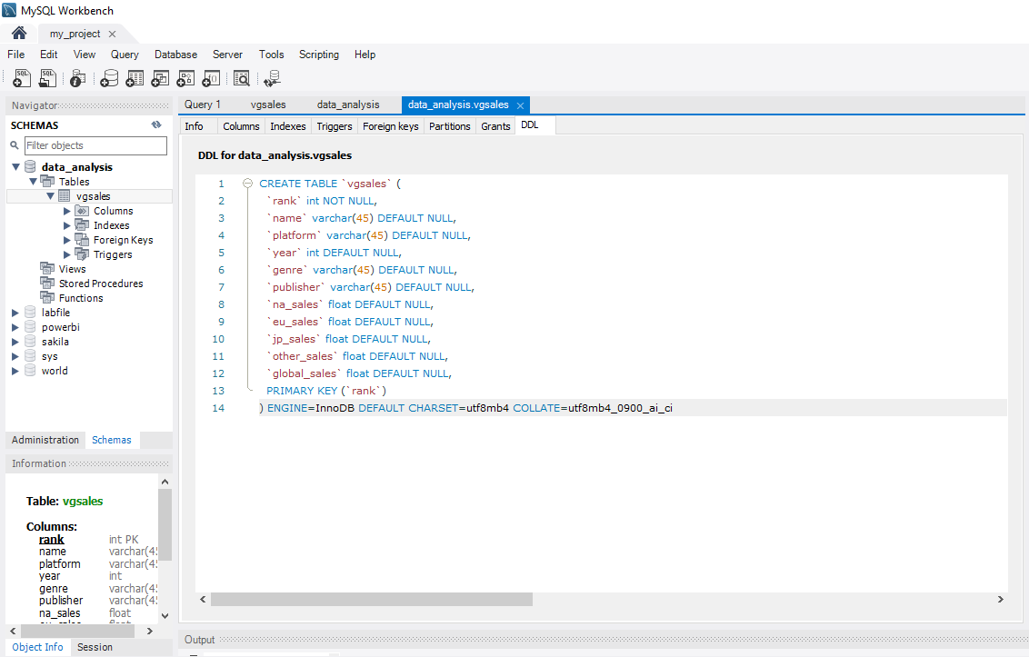
Data Analysis using Structured query language
Step 1: At first I import my csv file in my sql workbench,for this I created the same number of column header of excel files in sql workbench as shown in the below image.

Slide 5
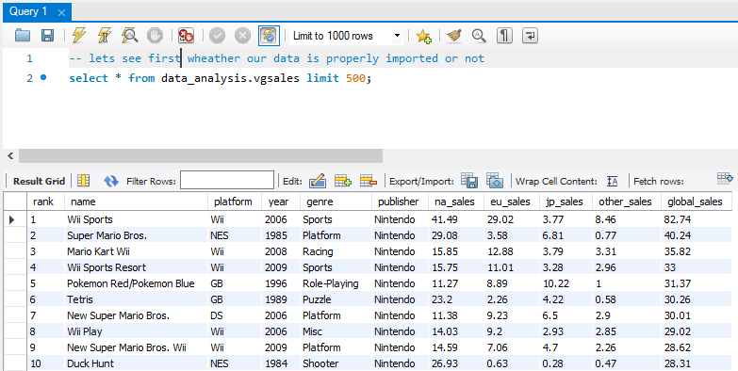
Analysis of dataset using Sql queries:-
After importing my csv file I first checked wheather my data is imported or not properly . For this I used query as you seen in below image:
I faced no error and difficulty while importing our csv file , so our dataset is imported properly in my SQL workbench and we do some further analysis…!!!!

Slide 6
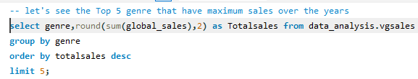
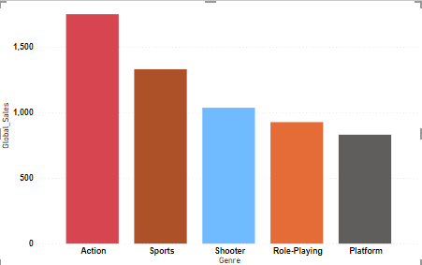
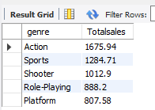
Analysis continued
SQL Query to see top 5 genre of games that have maximum sales over the years.
According to the output the top five genre that have maximum or highest global sales over the year are Action, Sports, Shooter , Role playing and Platform.
Among all these genre action is the most popular genre

Slide 7
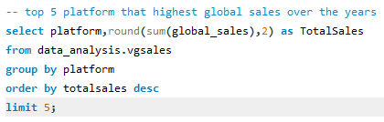
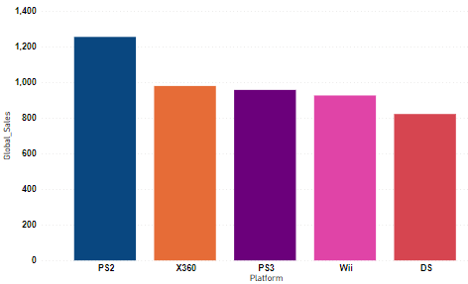
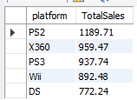
SQL query to see top 5 platform that have maximum global sales over the period
According to the output the top 5 platform that have maximum or highest global sales are:
PS2,X360,PS3,Wii,DS.
As we see the platform PS2 has the maximum global sales among the others platform and popular among gamers.

Slide 8
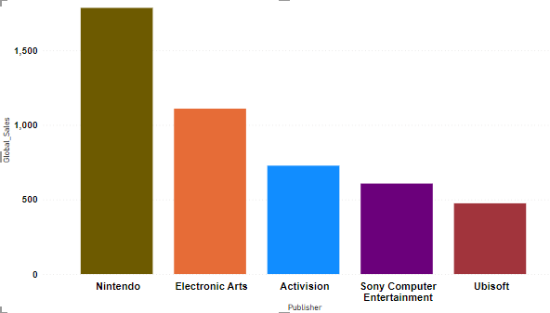
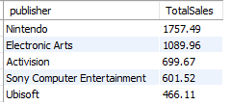
SQL query to find top 5 publisher that got maximum games sales globally
As we see the top 5 publisher that got highest sales globally are: Nintendo, Electronic Arts, Activision, Sony Computer Entertainment and Ubisoft.
Among all these publisher Nitendo is the most famous publisher that got highest global sales.

Slide 9
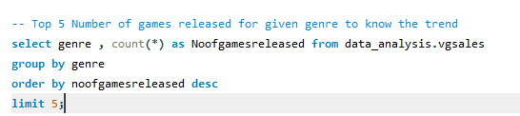
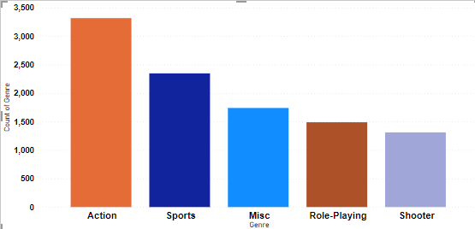
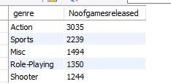
SQL QUERY of Top 5 Number of games released for given genre to know the trend
The top 5 genre that have highest number of games released are Action , Sports , Misc,Role-playing and shooter.
The Action genre has the highest number of game released which is 3035

Slide 10
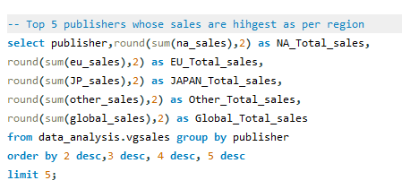
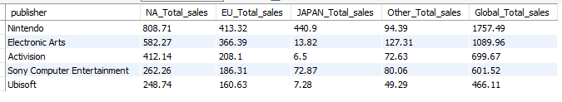
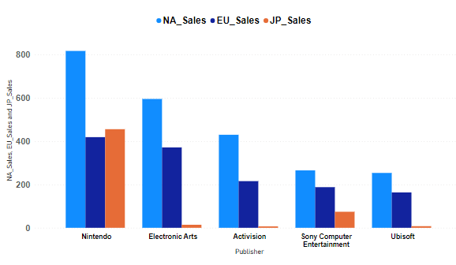
SQL query to find the top publisher whose sales are highest as per region
The top 5 publishers whose sales are the highest as per the region are:Nintendo,Electronic arts,Activision,Sony computer entertainment and Ubisoft.
Nintendo done highest sales among all the publisher in different region.

Slide 11
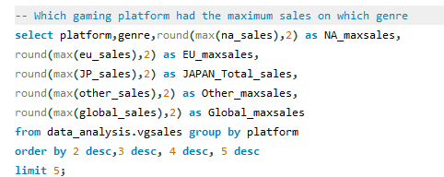
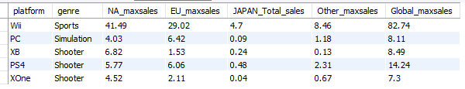
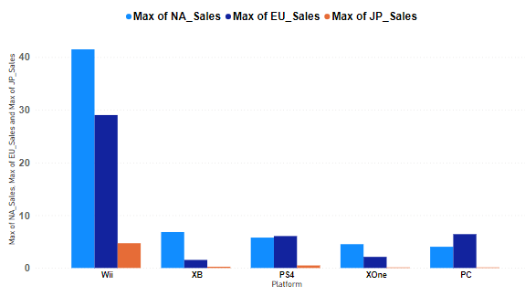
Sql query to find which gaming platform had the maximum sales on which genre
The top five gaming platform that have maximum sales based on genre are:Wii,PC,XB,PS4 and Xone.
Wii platform along with sport genre done the maximum sales in different regions.

Slide 12
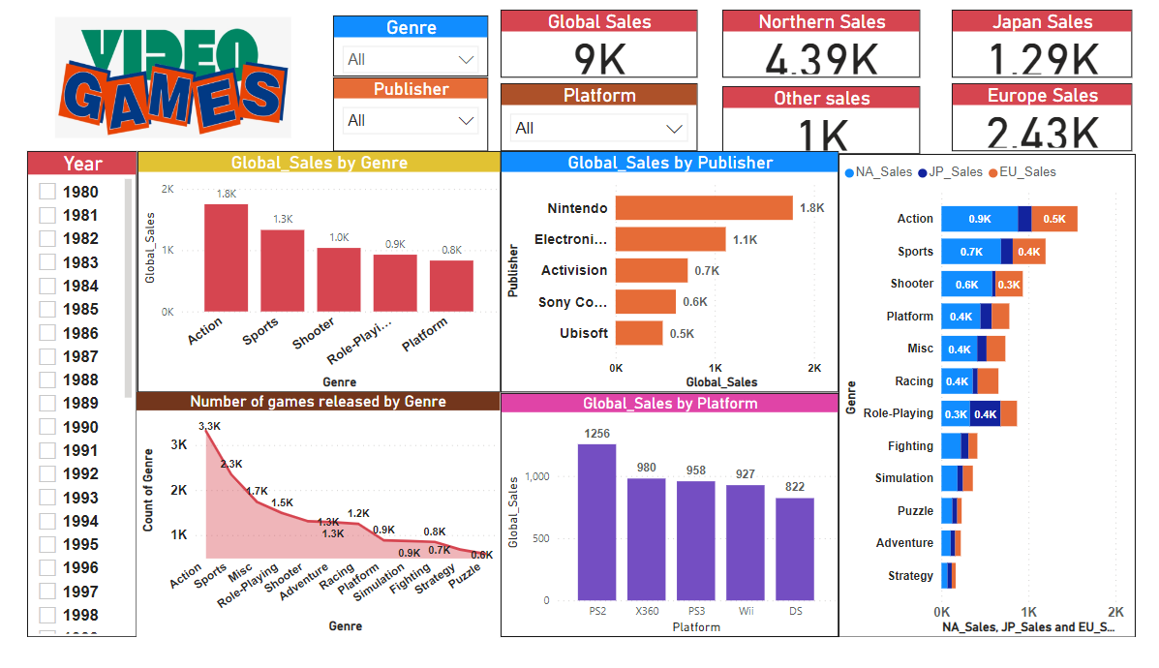
Dashboard Creation using Power BI

